Slide 1
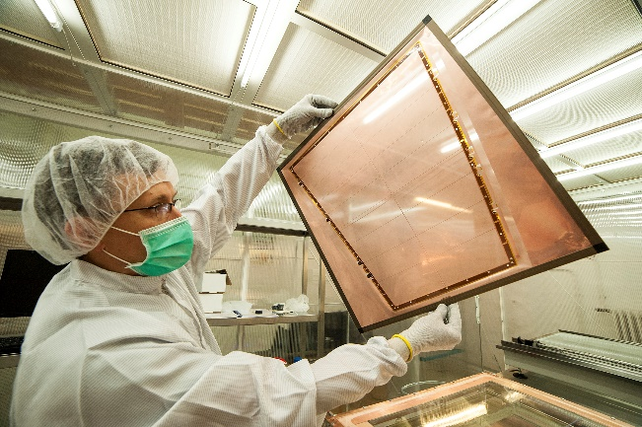
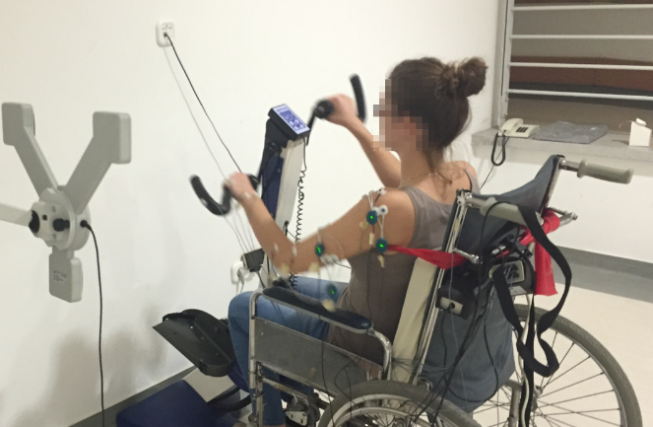
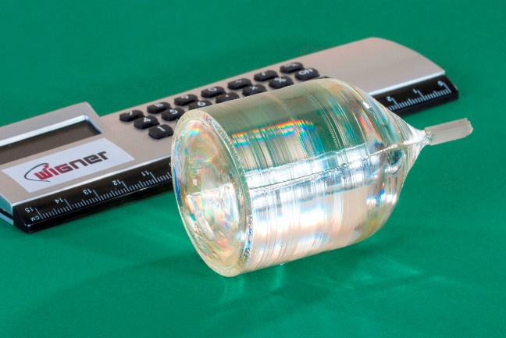
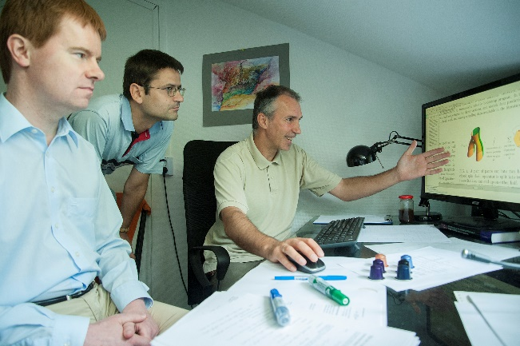
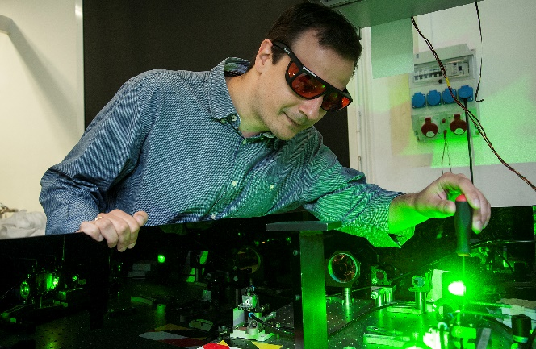
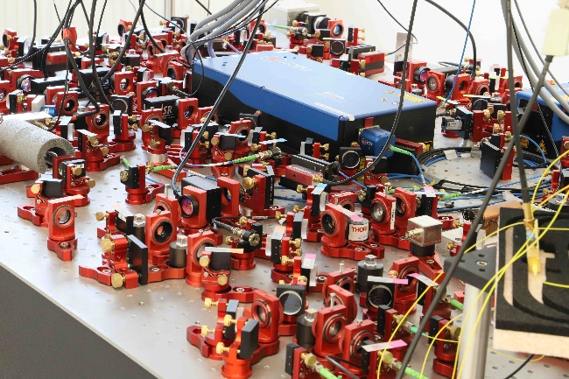


HUN-REN Wigner Research Centre for Physics
Research.
Innovation.
Impact.

Slide 2
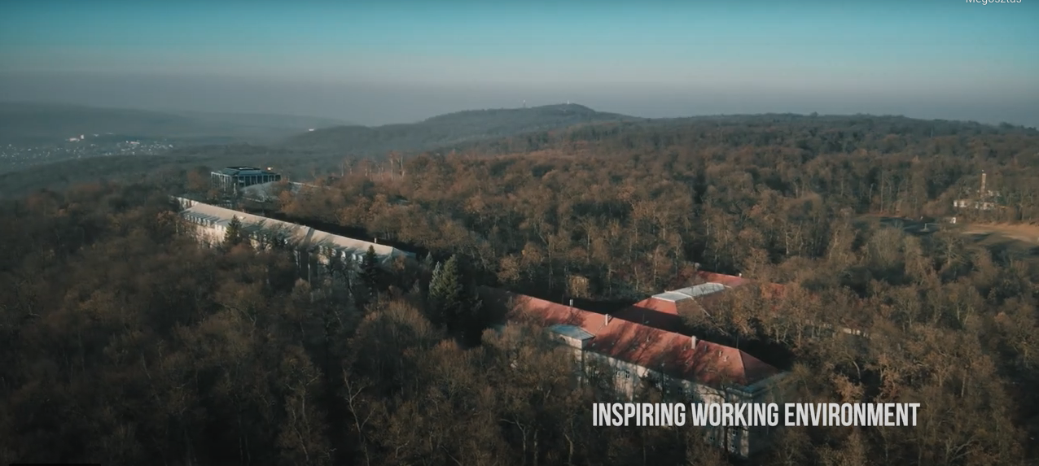
Research campus
Facilities
The campus of Central Research Institute for Physics (KFKI) was
founded in 1950
basic and applied research institutes
spin-off companies
nuclear reactor
mechanical end electronic workshops
Wigner data centre

Slide 3
HUN-REN Wigner Research Centre for Physics
Mission
Basic research in local laboratories and at large-scale international facilities, coordination of national and international collaborations, formation of an excellent theoretical knowledge base and the translation of scientific results to applications via industrial cooperations.

Slide 4
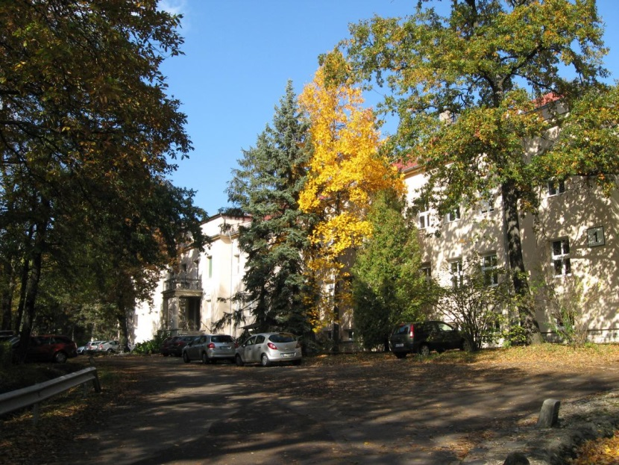
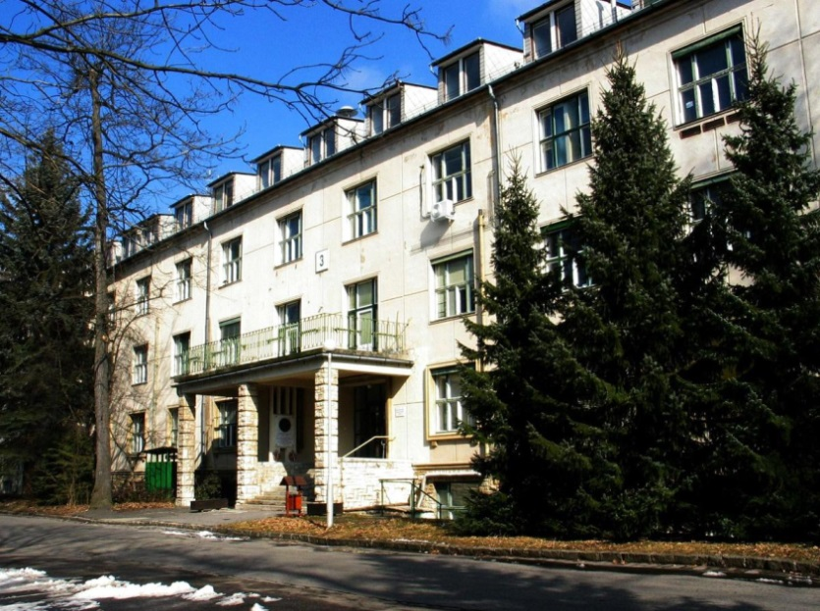
HUN-REN Wigner Research Centre for Physics
Institute for Particle and Nuclear Physics
elementary interactions and extreme states of matter
search for unknown particles and fields
innovative solutions for novel accelerators and particle detectors
radioactive nuclear methods in material science creating functional materials
space physics
space probes
space weather in the Sun system
computational sciences
machine learning and artificial intelligence
quantum computing
Institute for Solid State Physics and Optics
advanced and complex materials
      new methods of spectroscopy for nanomaterials, ranging from infrared to x-ray techniques
      synthesis of novel carbon based materials
      computational material science
photonics
femtosecond laser pulses
applications ranging from opto-electronics to biomedical optics
quantum physics and quantum technology
ab initio characterisation of solid-state defect quantum bits
dissipative quantum many-body systems
quantum information processing

Slide 5
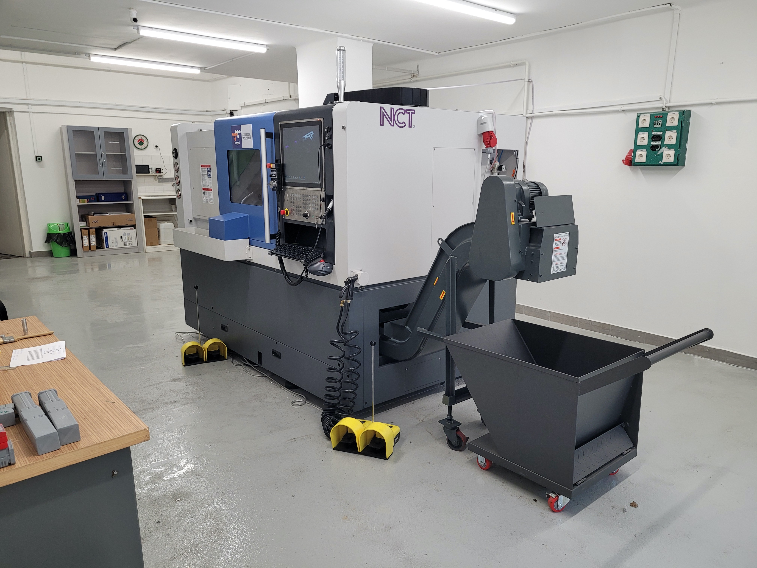
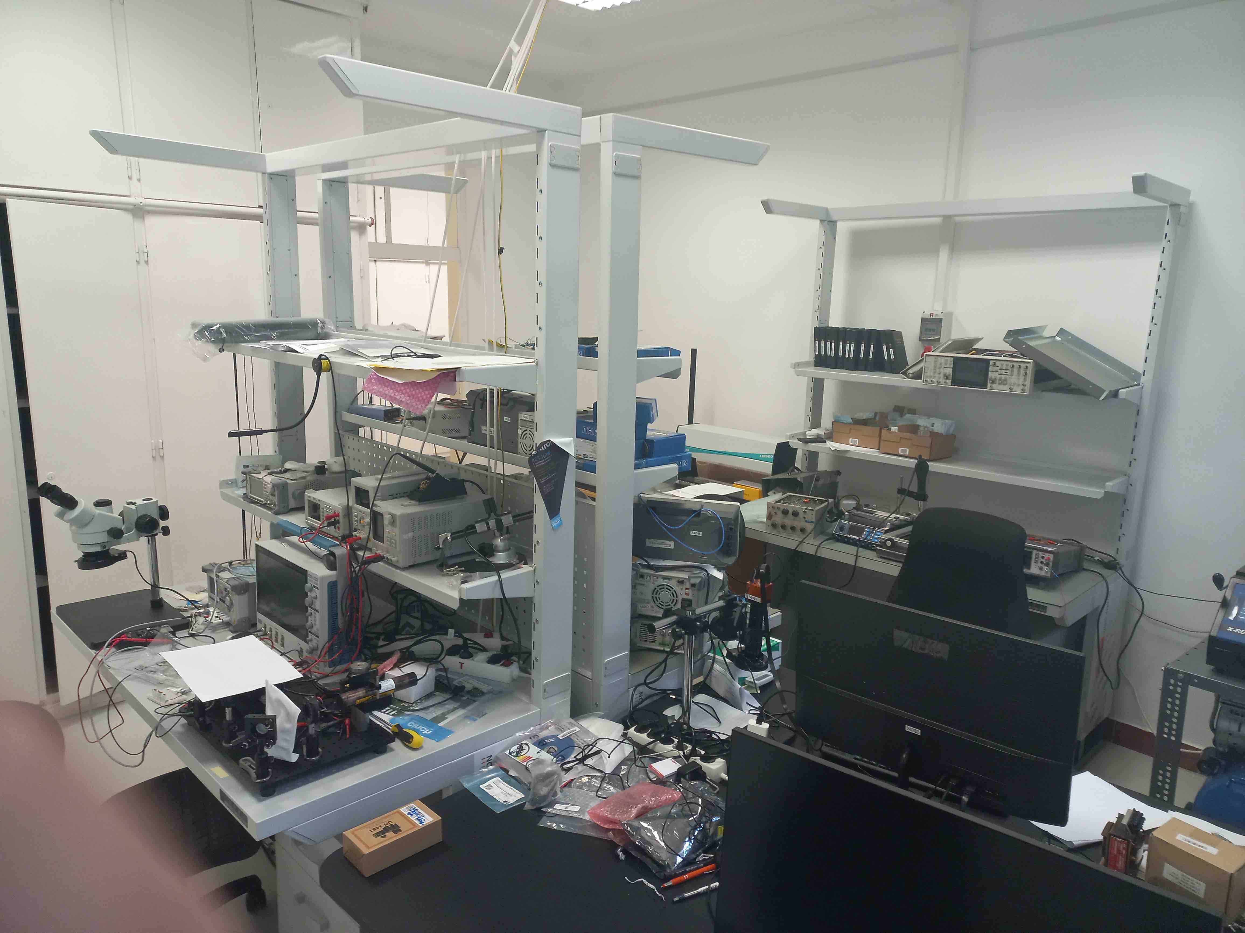
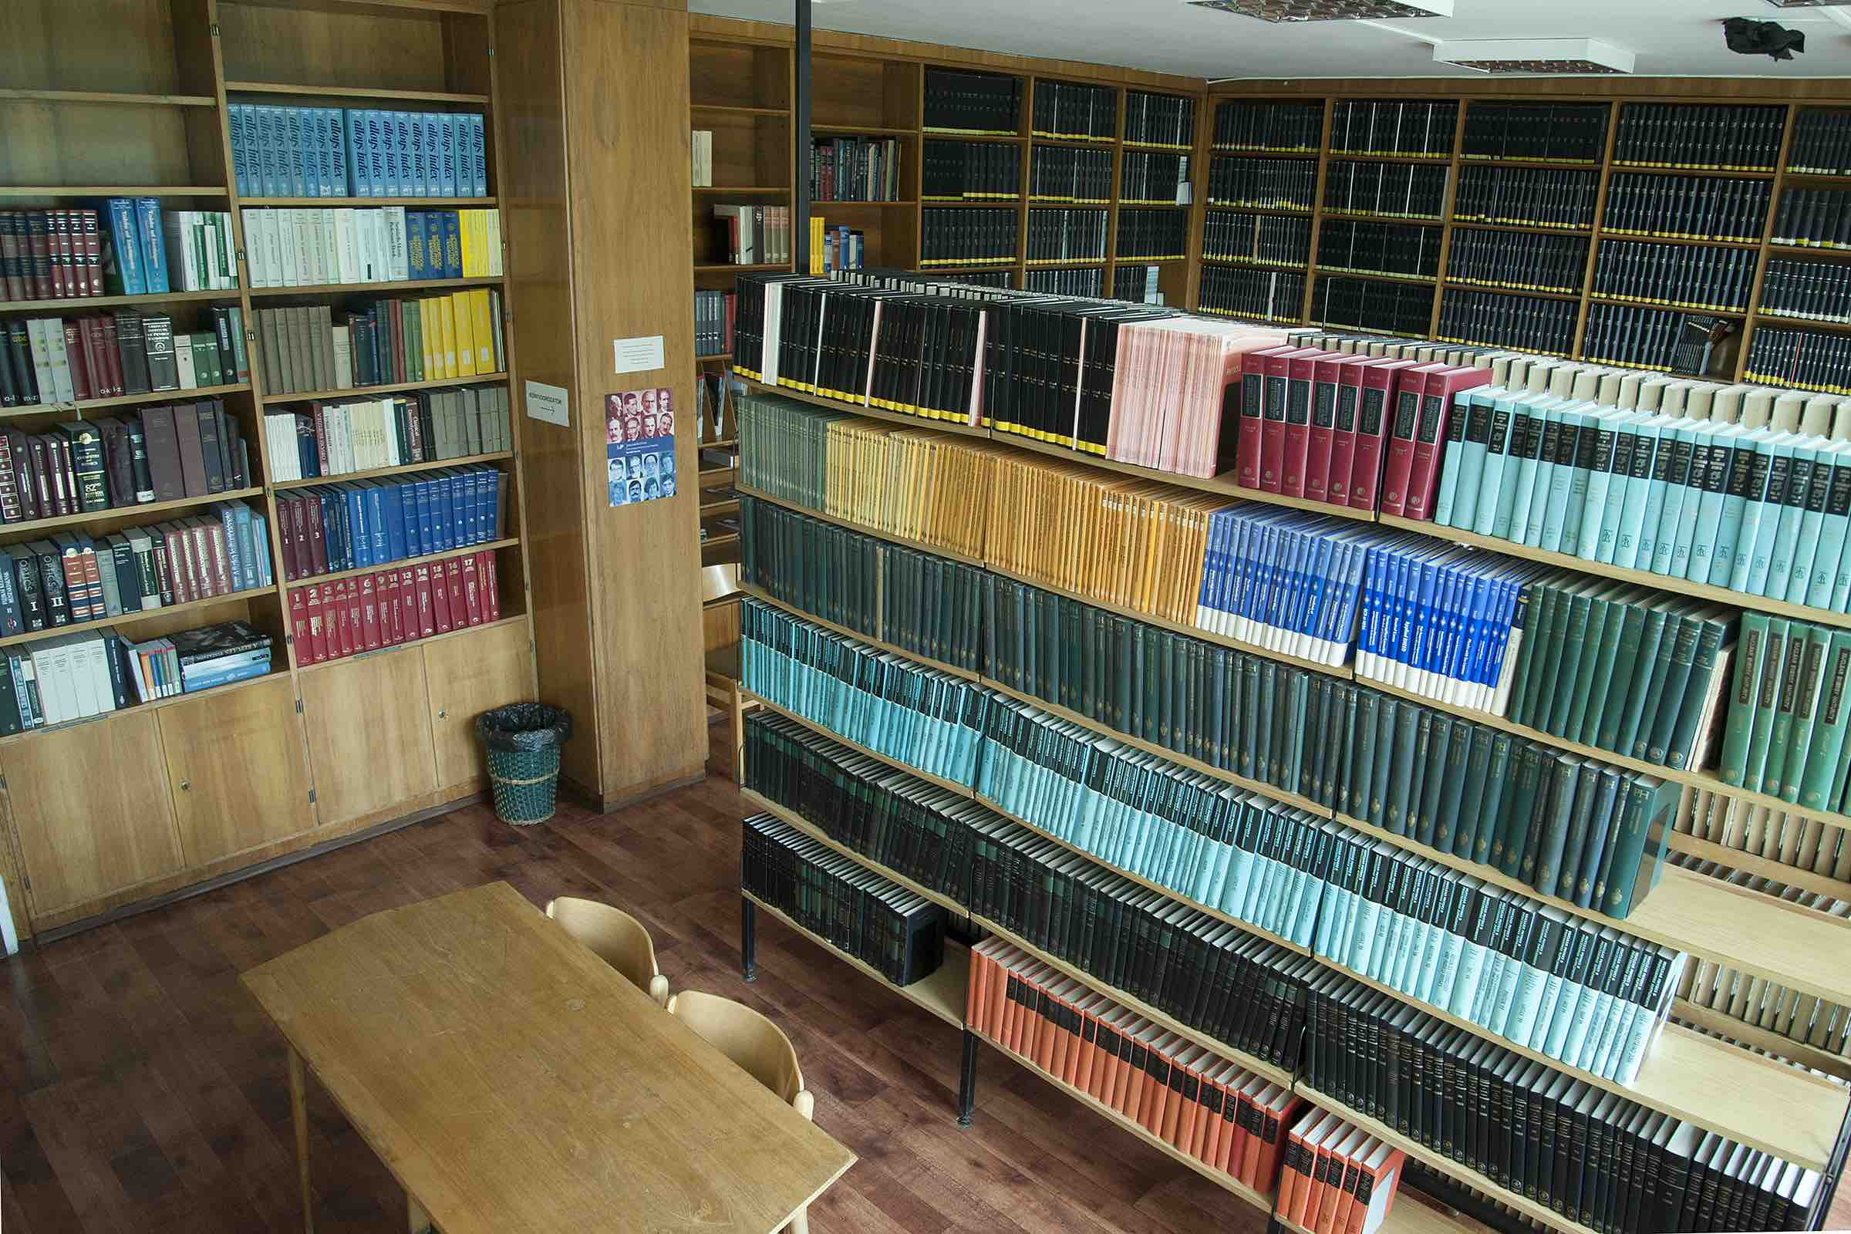
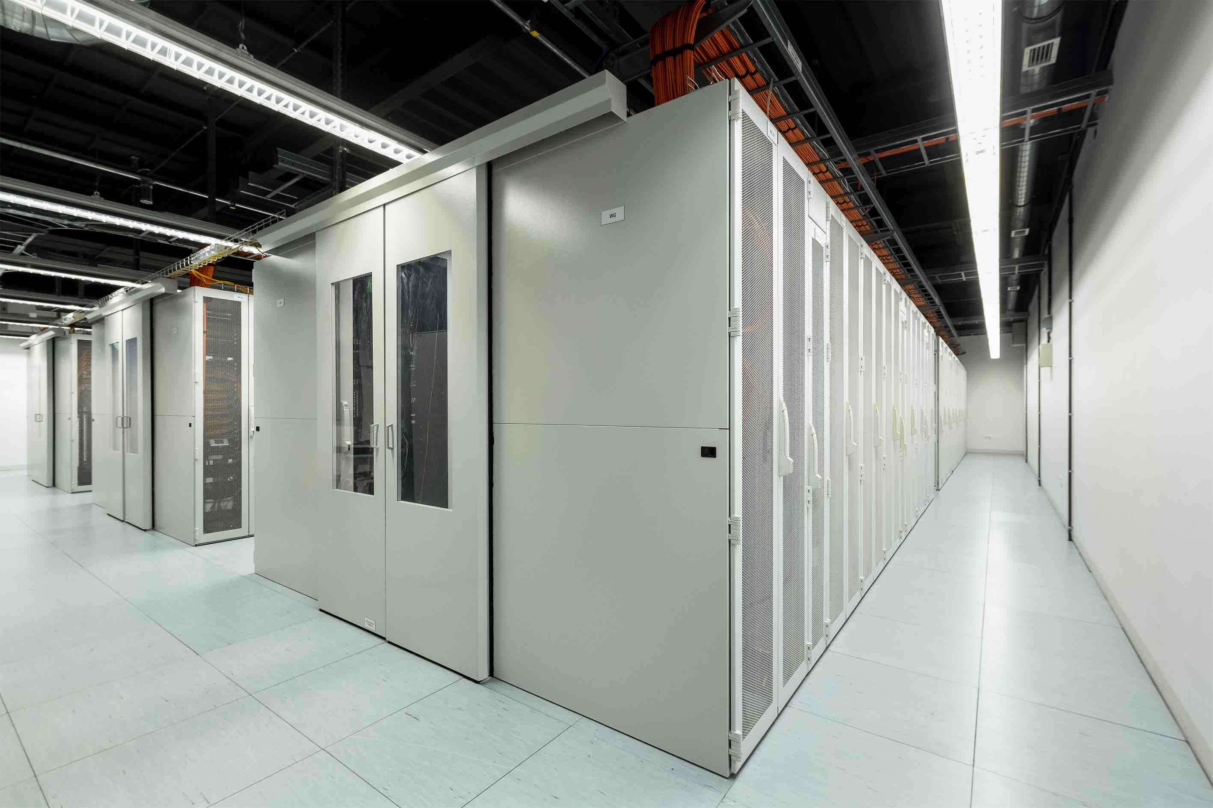
Facts about HUN-REN Wigner RCP (2024)
Human resources
328 employees
219 researchers
36 research groups
33 Doctor of the Hungarian Academy of Sciences (scientific advisor)
141 PhD (senior researcher or postdoc)
45 PhD students
Mechanical and electronic workshops
Projects and collaborations
2 national laboratories (consortium leader)
97 NRDIO projects (national)
19 EU consortial projects
3 international projects
19 industrial partners
522 scientific papers in 2024
Library
Wigner Data Centre

Slide 6
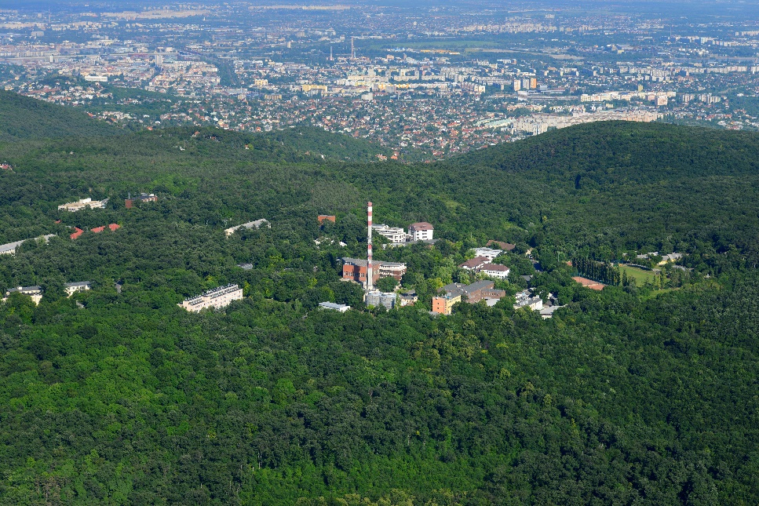
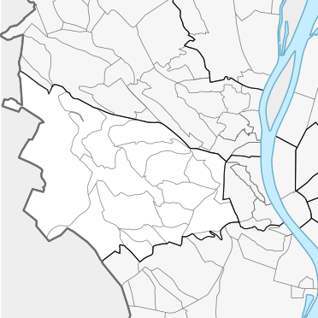



HUN-REN Wigner Research Centre for Physics
Photo: EK
Wikipedia
Photo: Béla Selmeci

Slide 7
HUN-REN Wigner Research Centre for Physics
Institute for Particle and Nuclear Physics
Particle and Nuclear physics, theoretical physics, space physics, nanoplasmonic laser fusion, information technology, computational sciences, neurorehabilitation
Institute for Solide State Physics and Optics
Quantum computing, complex systems,
physics of luiquids, laserphysics, optics,
solid state physics, crystalphysics

Slide 8
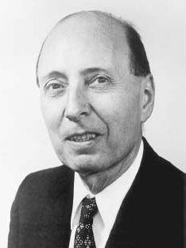
HUN-REN Wigner Research Centre for Physics
KFKI RMKI
Institute for Particle and Nuclear Physics
Eugene Wigner
1902 – 1995
SZFKI
Institute for Solid State Physics and Optics
HAS
WIGNER Research Centre for Physics
HUN-REN WIGNER Research Centre for Physics
KFKI
Central Research Institute for Physics
KFKI AEKI
Institute fo Nuclear Research
HAS
Centre for Energy Research
HUN-REN Centre for Energy Research
IKI
Institute for Isotope Research
MFA
Technical Physics and Material Science
1950 1992 2012 (14) 2019(ELKH) 2023

Slide 9
HUN-REN Wigner Research Centre for Physics
KFKI RMKI
Institute for Particle and Nuclear Physics
SZFKI
Institute for Solid State Physics and Optics
HAS
WIGNER Research Centre for Physics
HUN-REN WIGNER Research Centre for Physics
KFKI
Central Research Institute for Physics
KFKI AEKI
Institute fo Nuclear Research
HAS
Centre for Energy Research
HUN-REN Centre for Energy Research
IKI
Institute for Isotope Research
MFA
Technical Physics and Material Science
1950 1992 2012 (14) 2019(ELKH) 2023

Slide 10

Our mission
Basic research
Research Groups
Table top experiments
National laboratories
Long term commitments
International large scale RIs
Industrial applications
Innovation Centre
Technology Transfer
Education
Trainee possibilities
Knowledge transfer

Slide 11
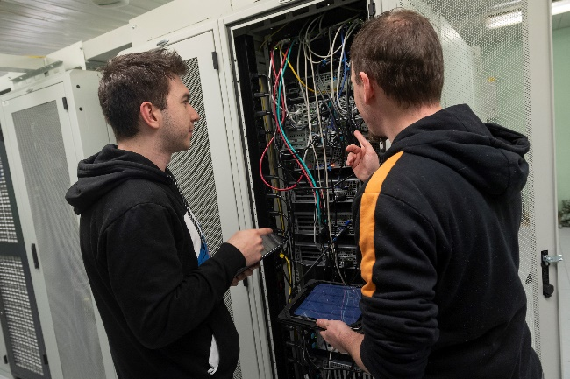
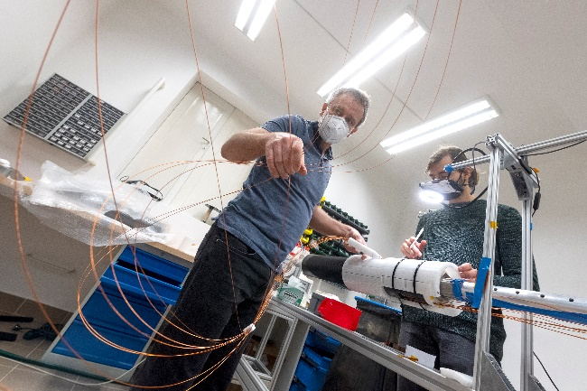



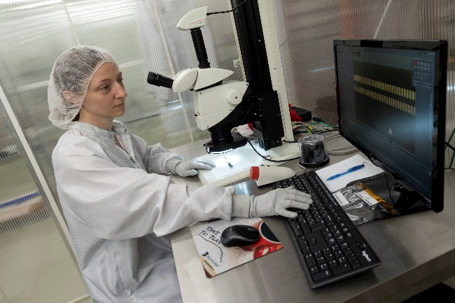
Main projects-Extensive research infrasturcture
1. High-energy physics

Slide 12
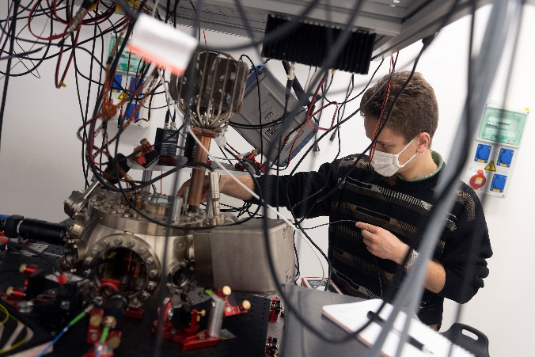
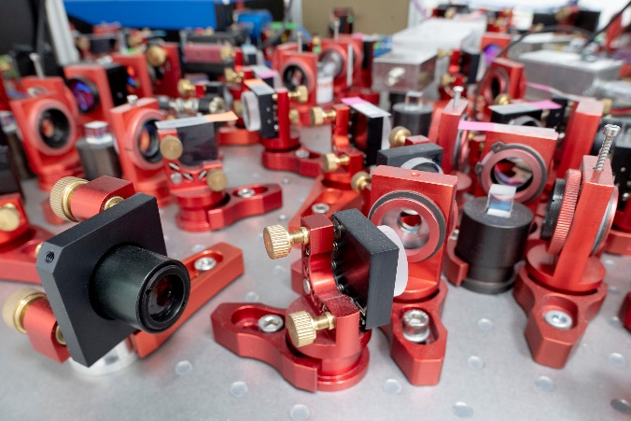
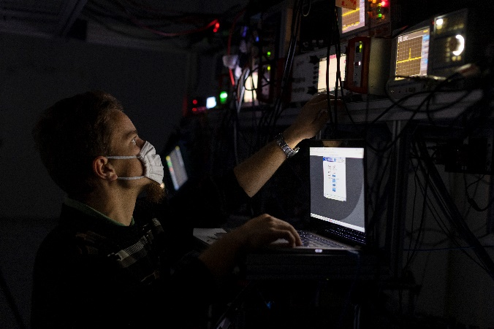
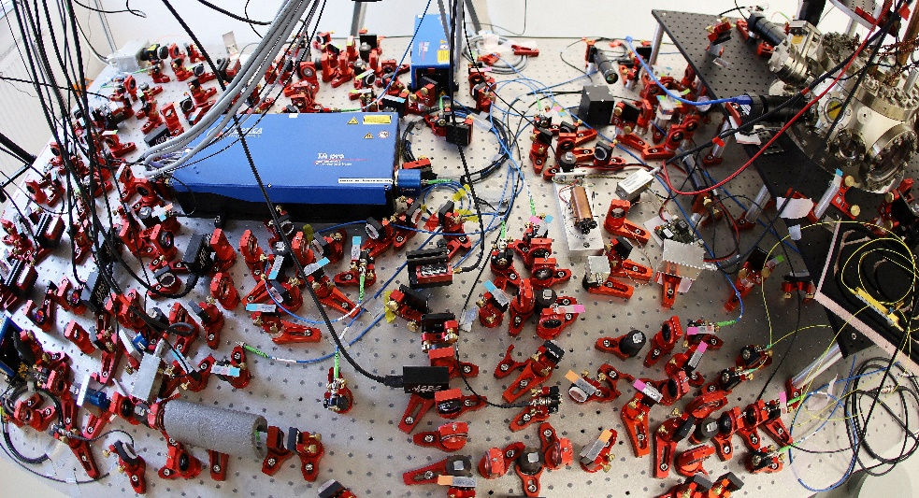
2. Quantum optics and quantum computing

Slide 13
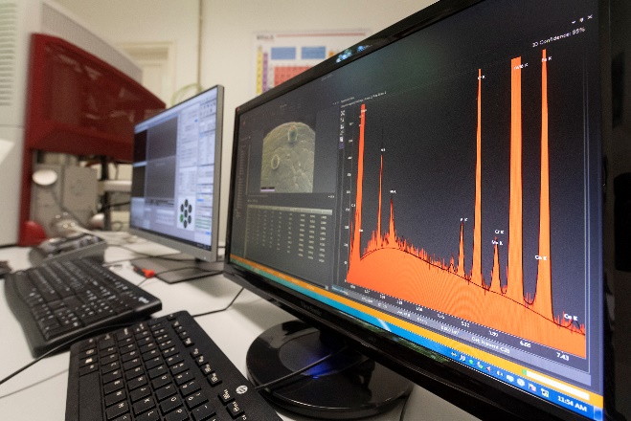
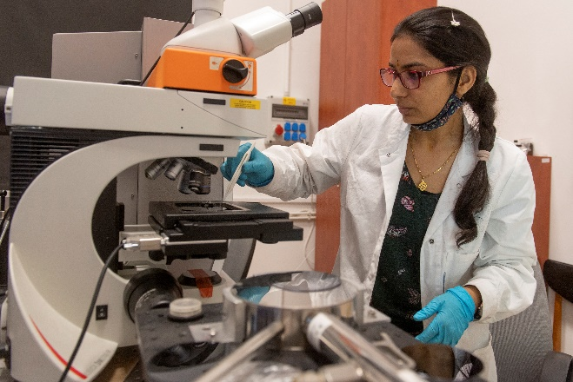
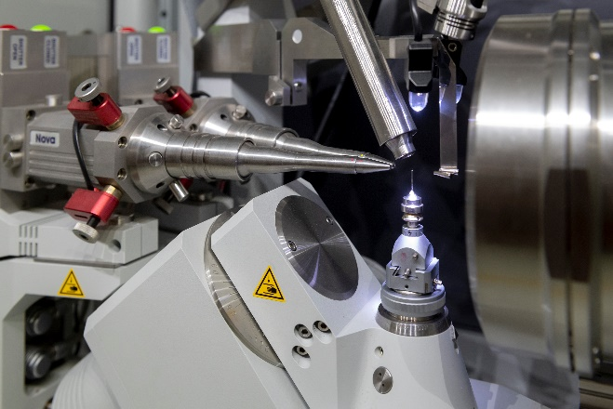
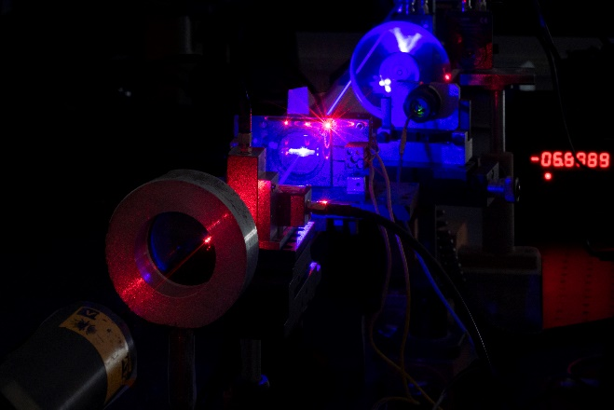
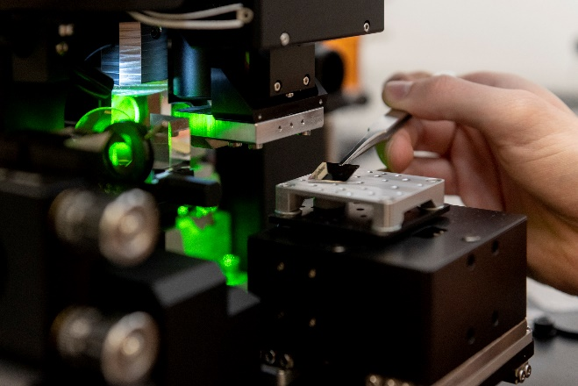
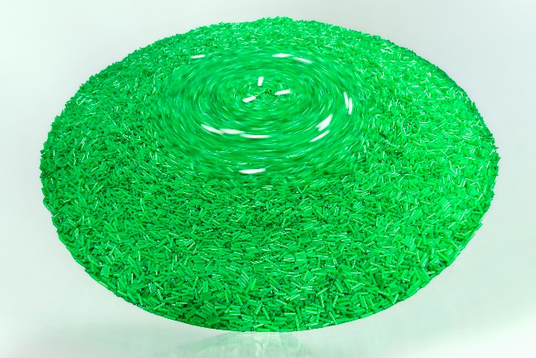
3. Modern material sciences

Slide 14
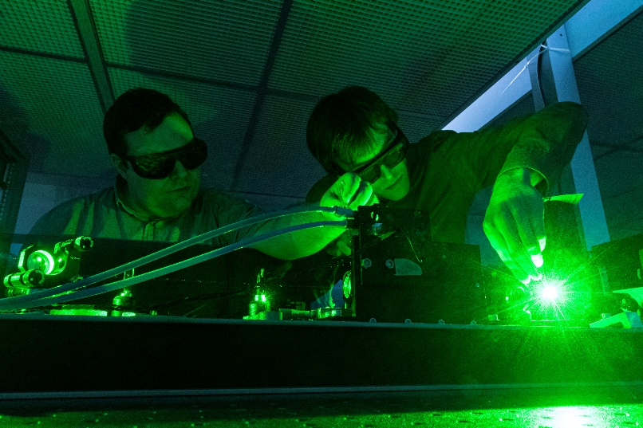
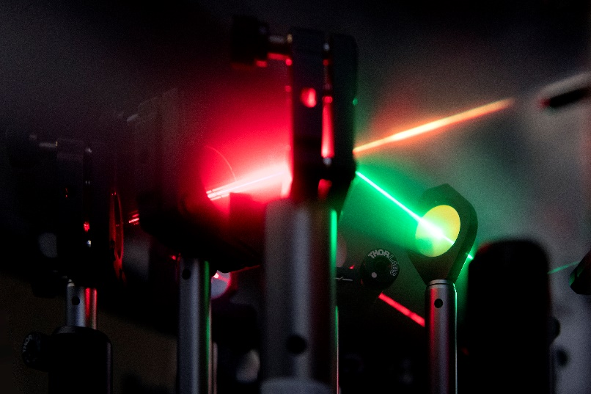
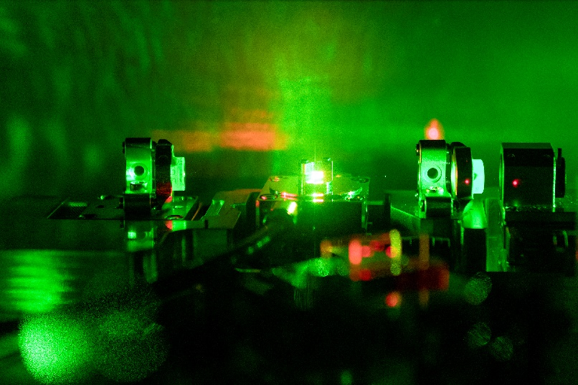
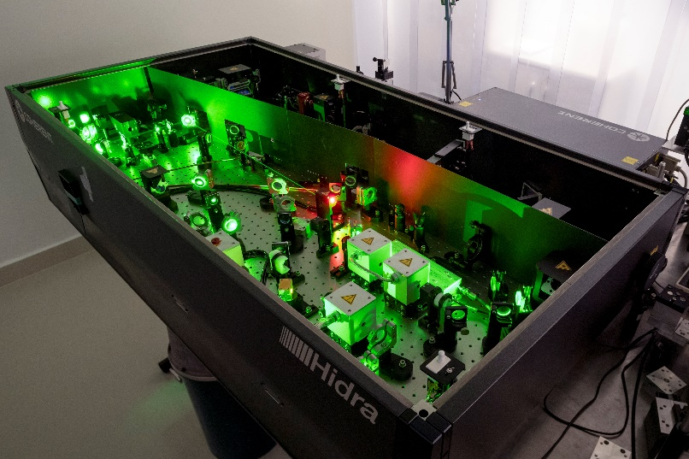
4. Laser physics [femtosecond lasers → attosecond ]

Slide 15
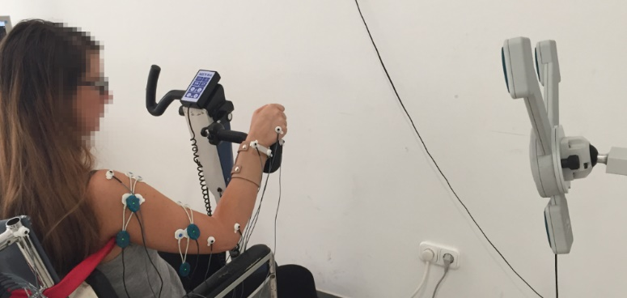
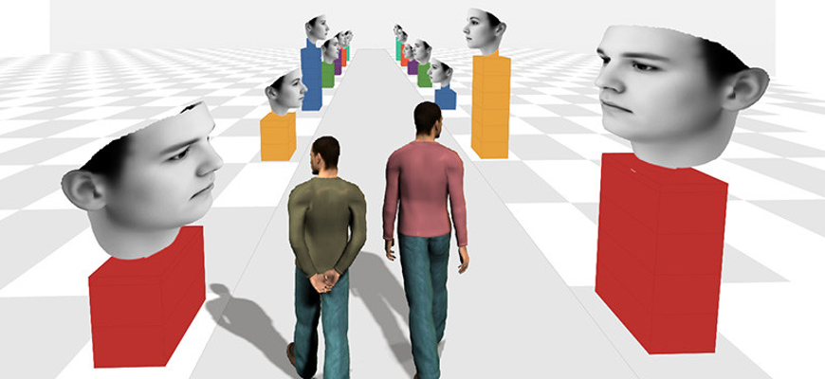
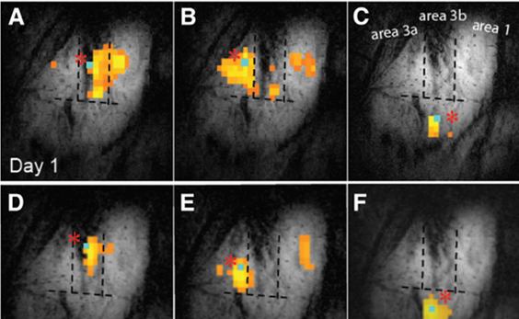
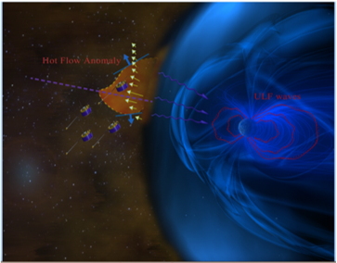
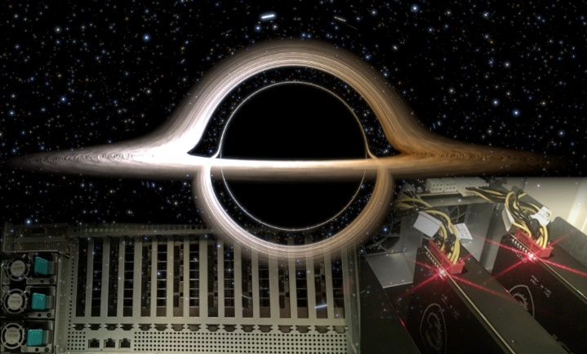
5. Computational and neuroscience, space physics
Rehabilitation technology
National Brain Research Program
Complex systems
Space physics
GPU laboratory

Slide 16

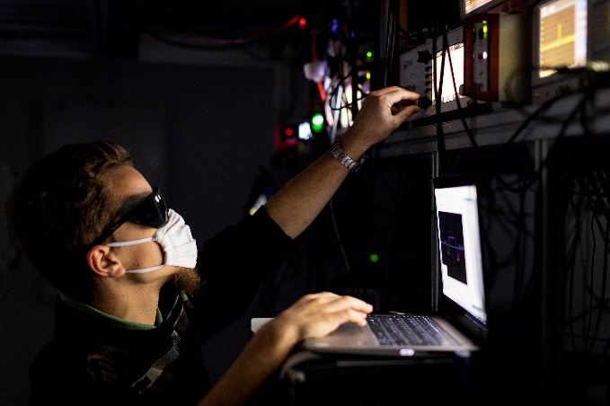
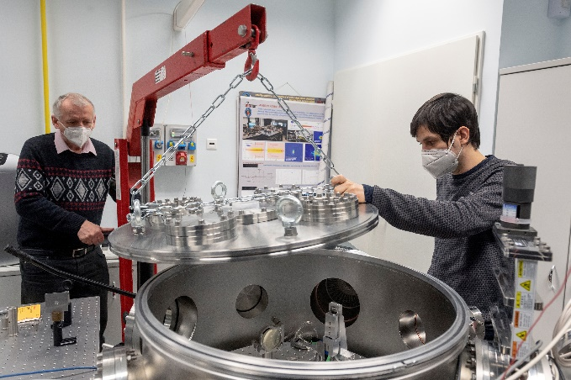
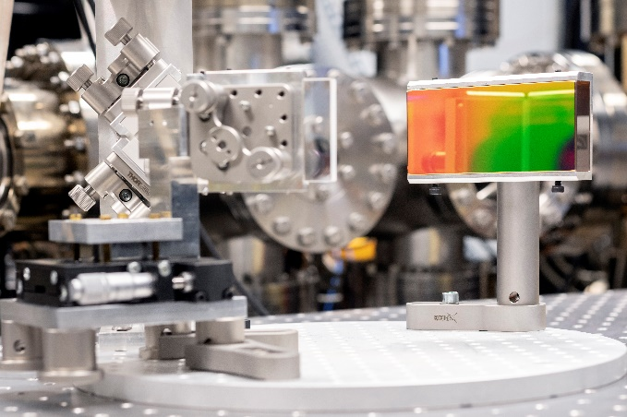
6. National and Research Laboratories
Quantum Information National Laboratory

Slide 17
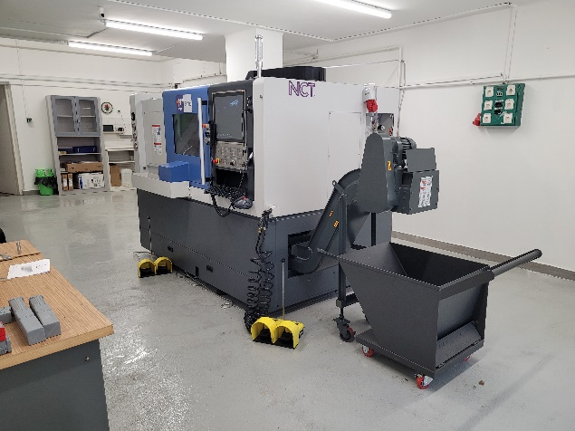
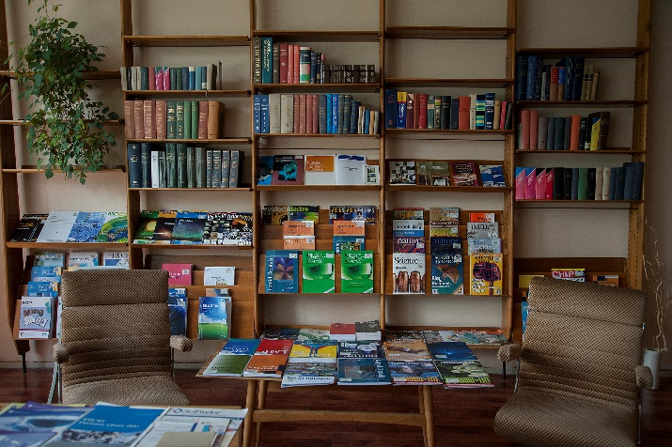
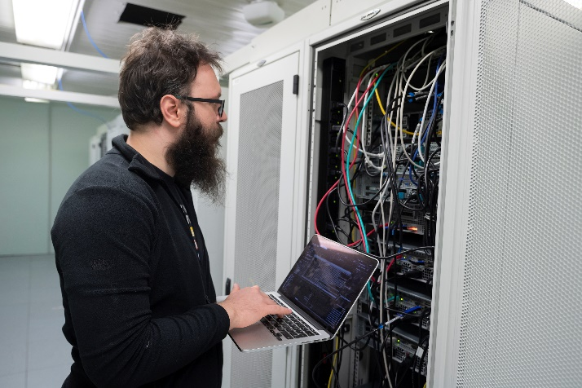


Infrasturctures
Workshop
Library
Computer Networking Center

Slide 18
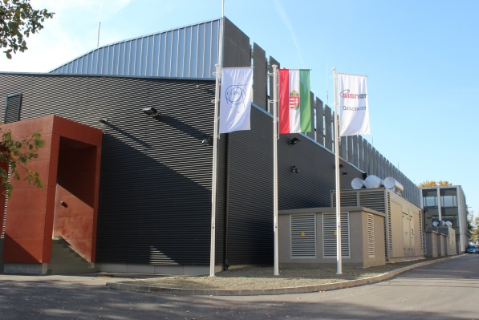
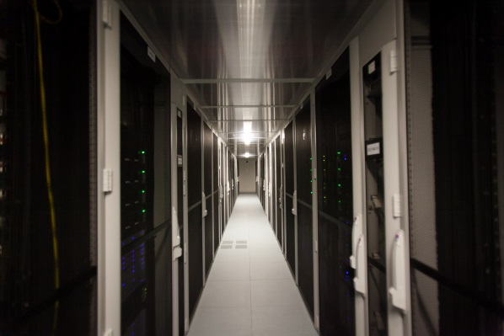
Wigner Data Centre
Energy efficiency and environmentally friendly infrastructure
Answer to the computational demand of the research and innovation
Innovative implementation of the concentrated, high energy density computing and data storage capacity
Mission: knowledge centre, knowledge transfer
- Events: Big Data Day, WSCLab, GPU Day, Multicore Workshop
Cloud service: HUN-REN Cloud (with HUN-REN Institute for Computer Science and Control)

Slide 19
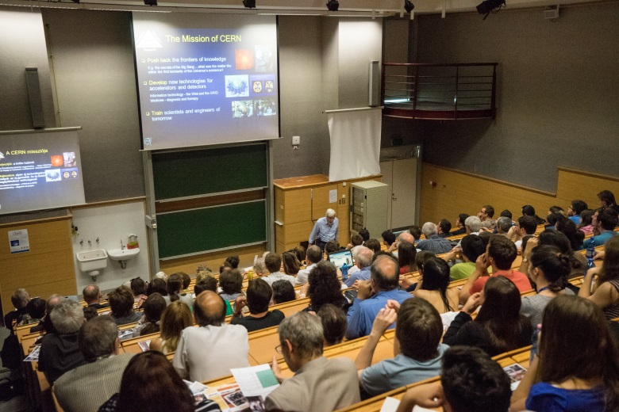
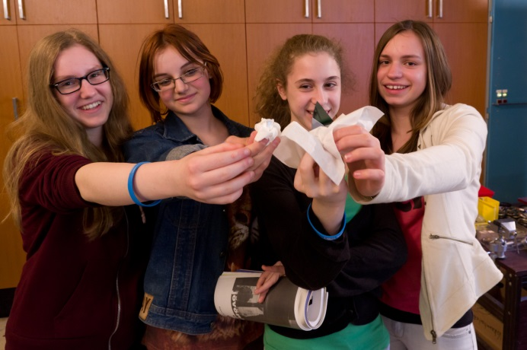



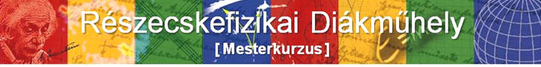
Education and outreach activities
University and PhD education
Leading of thesis and dissertations
Trainee programs
High school programs
Outreach events

